Slide 1
Strategy For: Rockbuster Stealth LLC
By: Ayla Arreguin

Slide 2

Introduction
Rockbuster Stealth LLC is a movie rental company with stores located around the world. Due to the increasing popularity of streaming services such as Netflix and Amazon Prime, the management team would like to launch an online video rental service to stay competitive. Before we are able to move forward with this transition, we need to answer key business questions by analyzing the data we currently have.

Slide 3
Overview
01
02
What Are The MOST RENTED MOVIES?
Table of contents
03
Where are Customers located?
Transition to online steaming services.
Top Genre & Ratings
04
WHO ARE THE TOP COUNTRIES?
05
WHO ARE THE TOP CUSTOMERS?

Slide 4
Overview
01
How can Rockbuster Stealth LLC enter the online streaming services world?
Goal: Provide strategy for online streaming services launch.
Which movies are rented most?
Which movies generate the most revenue?
Where are customers located worldwide?
Who are the top countries and cities?
Who are the top customers?
Using:
SQL
Excel
Tableau

Slide 5
02
Most Rented movies
BY GENRE & RATING

Slide 6
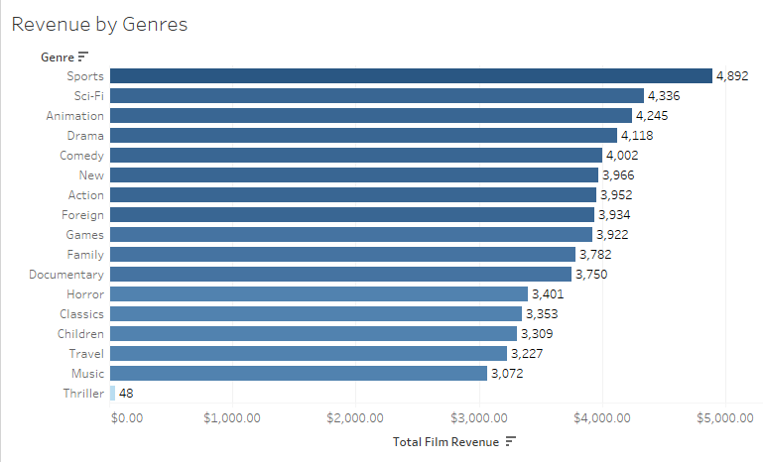
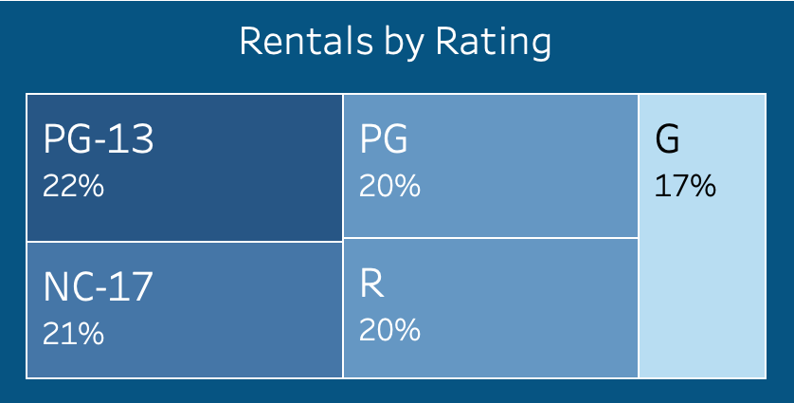
The top 3 genres by revenue are Sports, Sci-Fi, and Animation.
The top category in ratings is PG-13 at 22%.

Slide 7
03
Where are customers located?
By Country

Slide 8
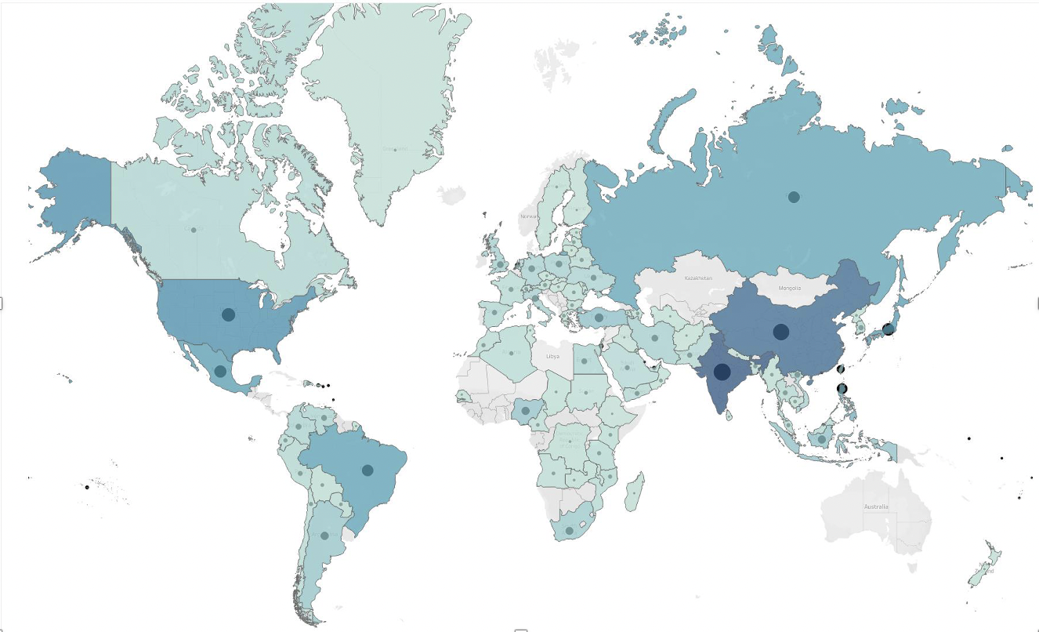
Rockbuster Stealth has customers all over the world.
India, China, and the United States are the top 3 countries by customer count.

Slide 9
04
What Are the top countries For Revenue?

Slide 10
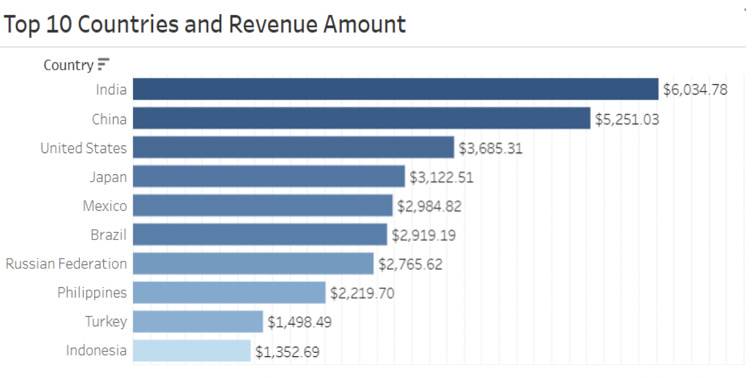
Again, the top 3 countries by revenue amount are India, China and the United States.
This indicates that there may be a correlation between customer count in each country and revenue amount.

Slide 11
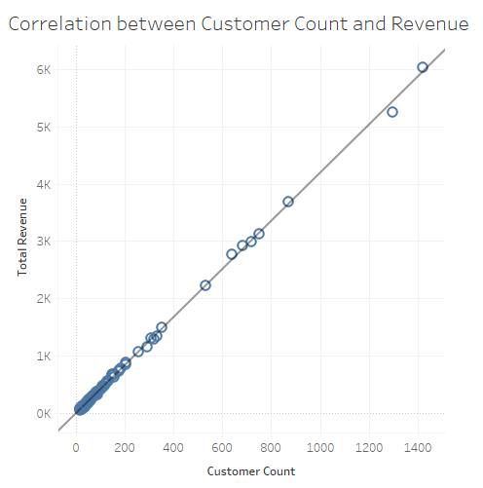
As predicted, we can see that there is a strong positive correlation between customer count and total revenue.
As customer count increases, so does total revenue.
Countries with more customers will produce higher revenue.

Slide 12
05
Who are the top customers?
By Revenue

Slide 13
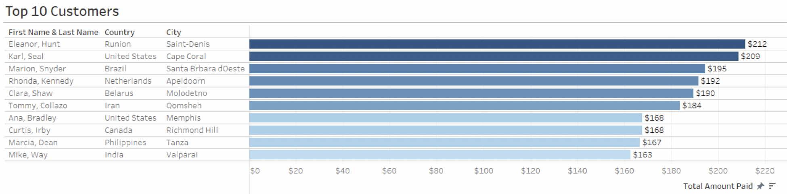
The top 10 customers are located all over the world.
It could be beneficial to offer a reward program for top customers in the future.

Slide 14
Recommendations
Prioritize films within most rented movie rating categories:
-PG-13
-NC-17
Focus on genres that are producing the highest revenue:
-Sports
-Sci Fi
-Animation
-Drama
-Comedy
Focus on increasing customer count to increase total revenue:
-Subscriptions
-Late fees
-Reward programs
-Referral benefits
Place less focus on genres that are the lowest revenue generators:
-Thrillers
Consider starting a loyalty membership to retain top customers.

Slide 15
Thank you
Data
Tableau Visualization

